Slide 1
A 2D Vortex Panel Method approach for modelling unsteady airfoil dynamics
Vedang Joshi
Department of Engineering
King’s College London

Slide 2
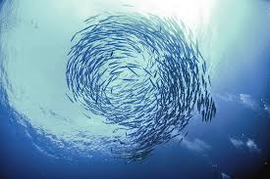
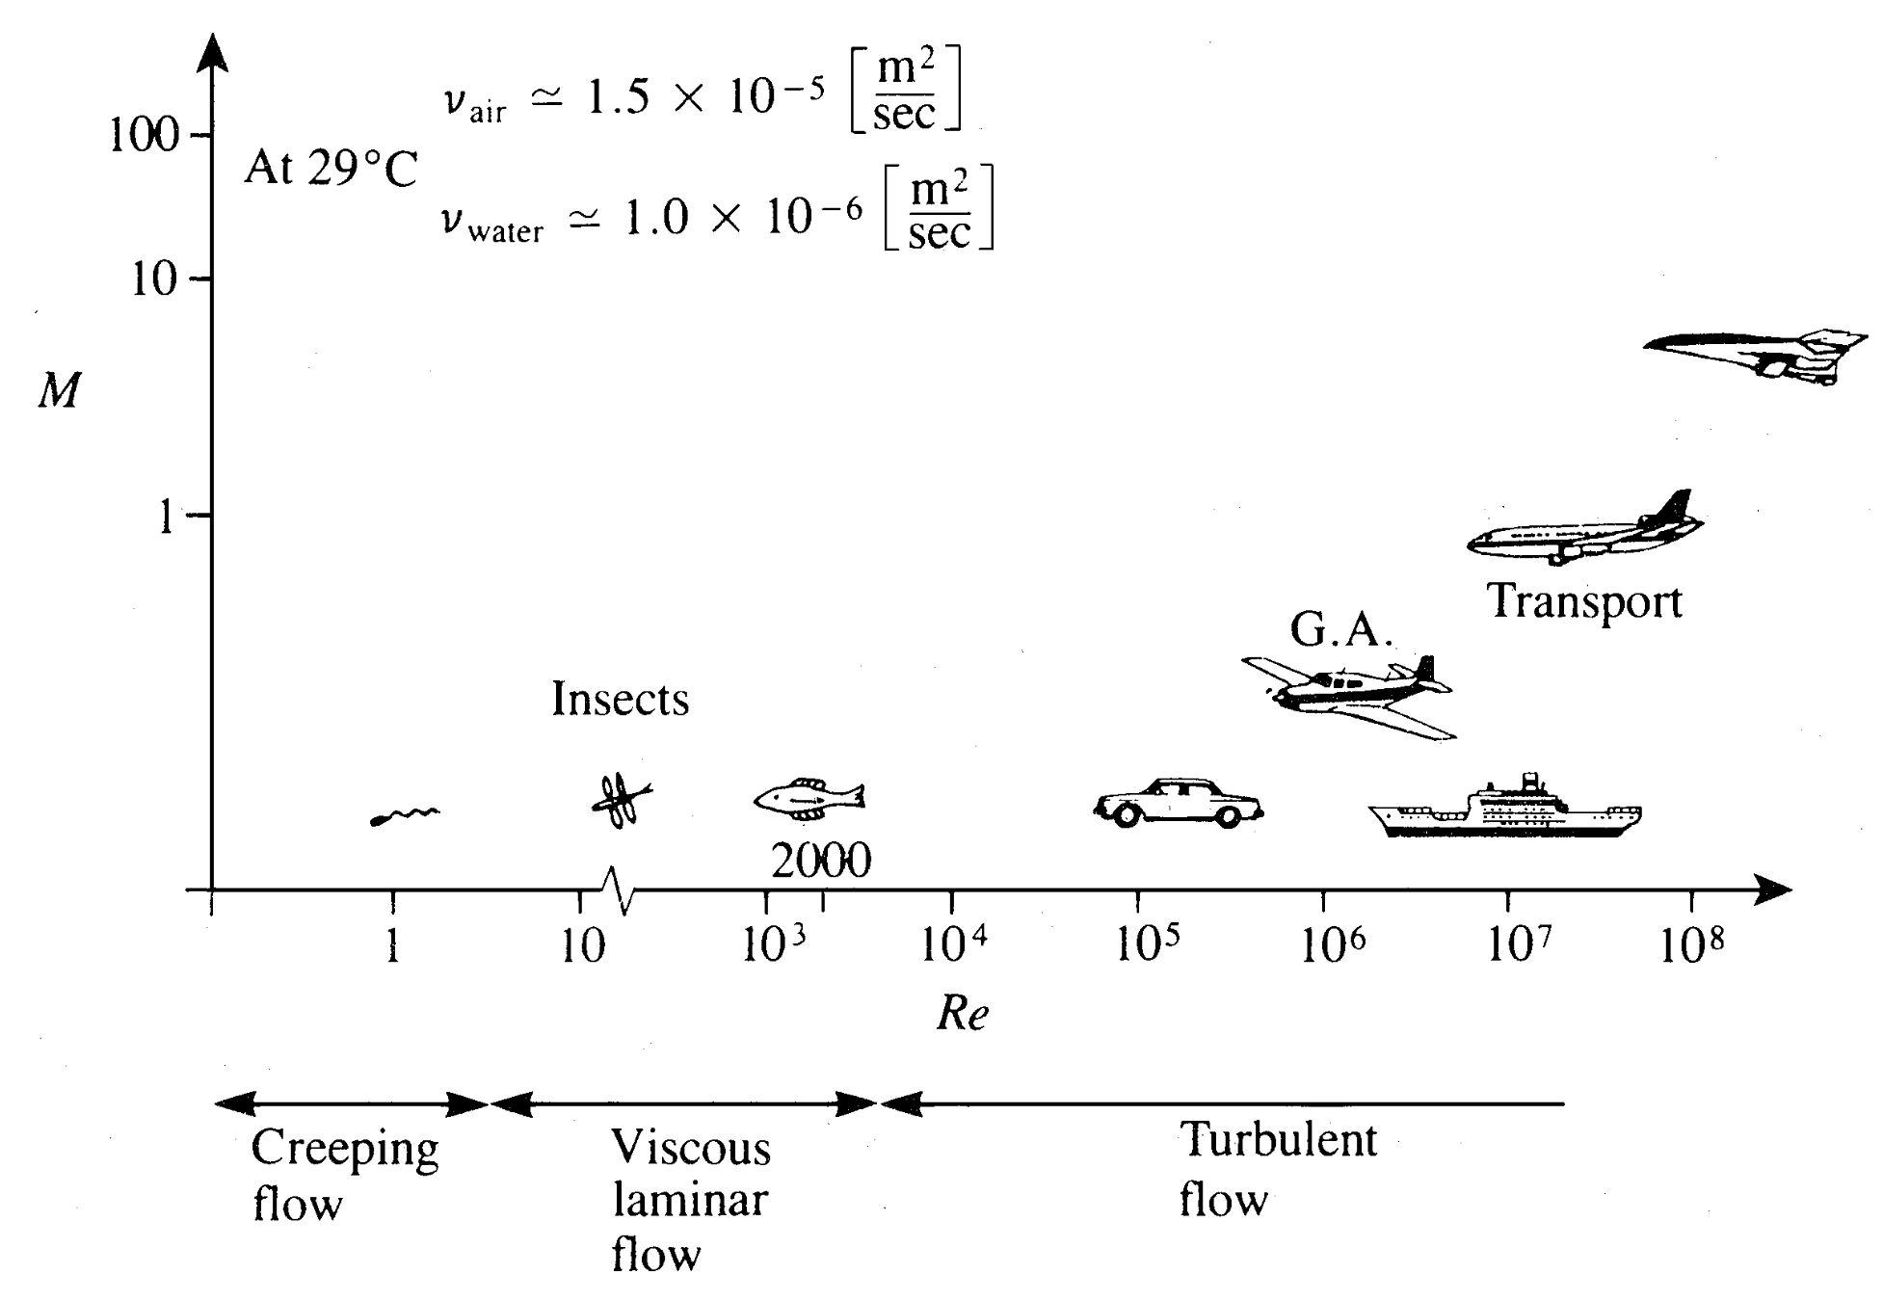
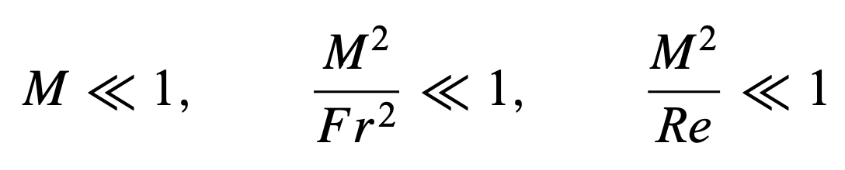
Introduction
Emergence of fish schools by studying the role of vortex shedding behind fish, using techniques from unsteady fluid dynamics.
Fish schools provide hydrodynamic benefits to individuals through flow-mediated interactions¹.
Fish schools achieve improved propulsive performance by harvesting energy from vortex wakes² enhancing thrust production³ or by reducing drag⁴.
[1] Weihs, D. (1973)
[2] Liao et. al (2003)
[3] Boschitsch et. al (2014)
[4] Maertens et. al (2017)
[5] JSTOR
[6] Katz, J. and Plotkin, A. (2001)

Slide 3
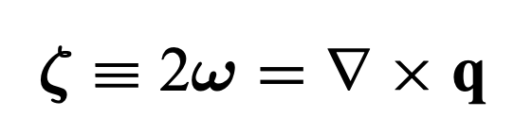
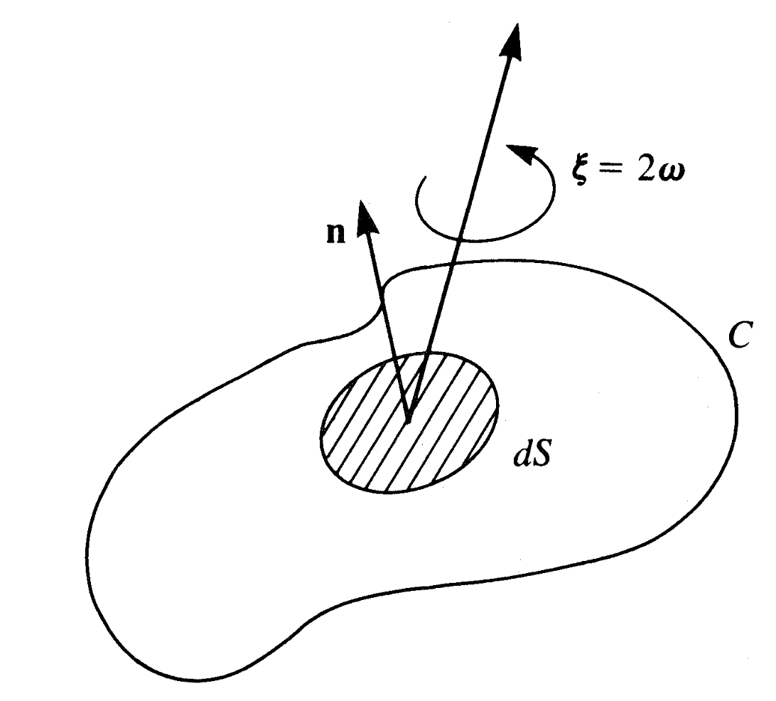
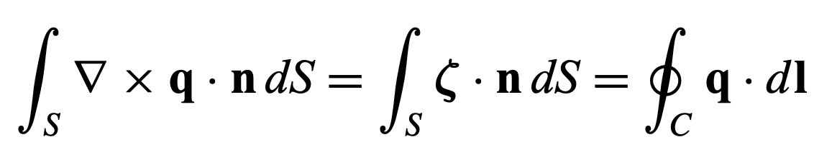
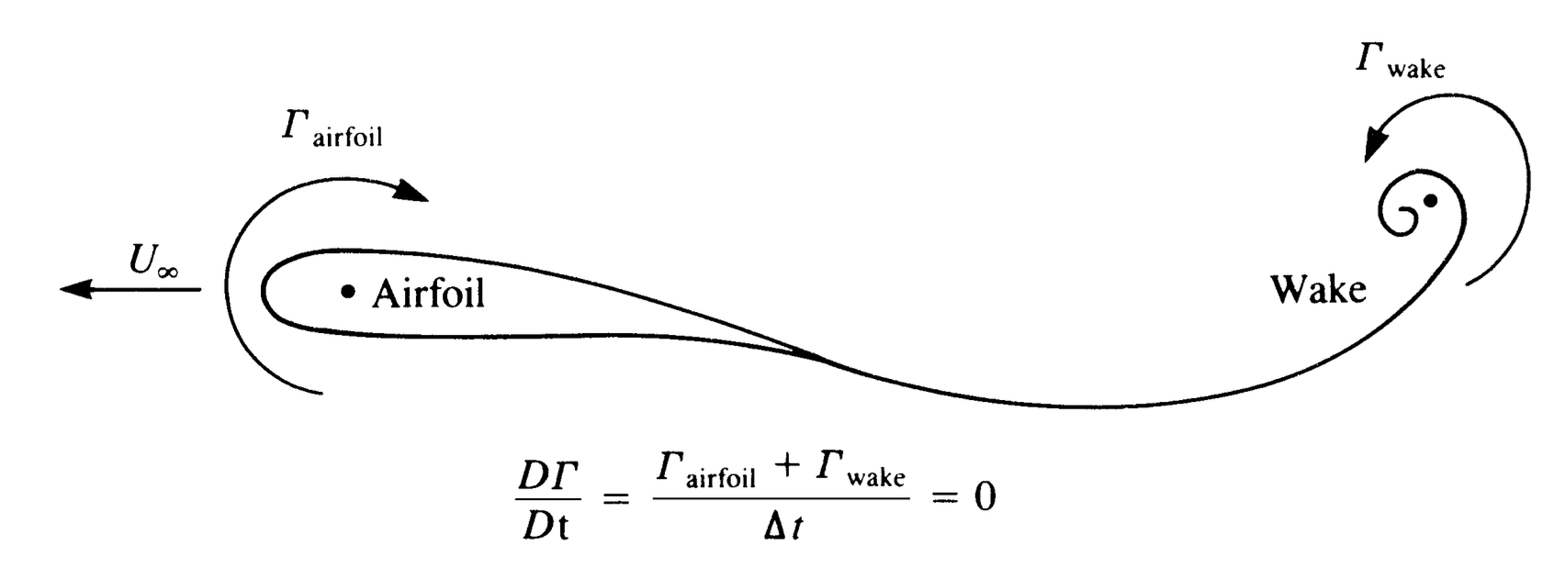
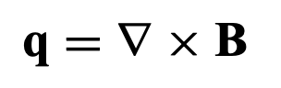
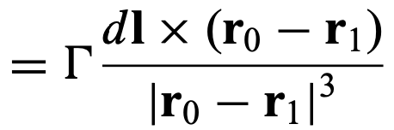
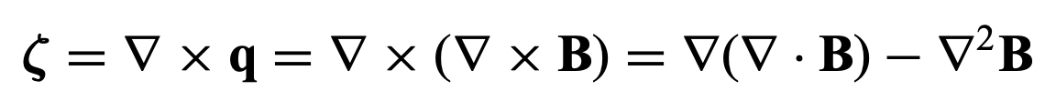
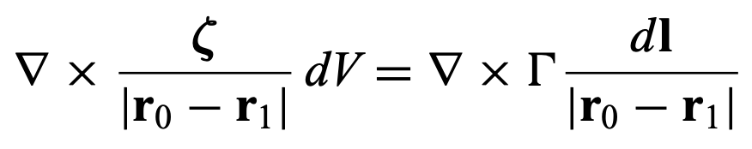
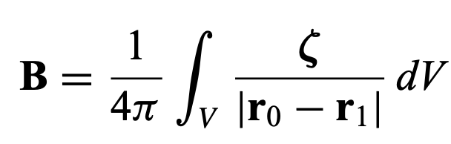
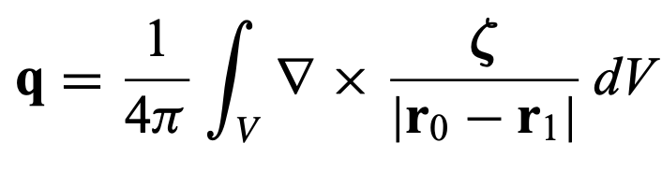
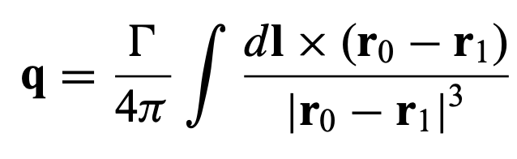
Rapid intro to Inviscid, Incompressible Flow
The vorticity is twice the angular velocity
We have an open surface S, and closed curve C
Kelvin’s theorem: Rate of change of circulation around closed curve with the same fluid elements is zero
Take a small cross sectional area dS, normal to the vorticity, with direction dl on the filament:
Biot-Savart Law: Determine the velocity field as a result of a known vorticity distribution
[1] Katz, J. and Plotkin, A. (2001)

Slide 4
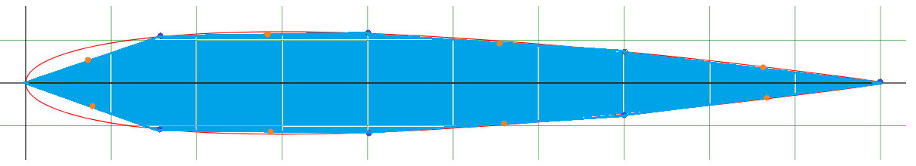
Panel Methods
Technique for solving incompressible potential flow over 2D and 3D geometries
In 2D, the airfoil surface is divided into piecewise straight-line segments/panels/boundary elements point vortex singularities of strength γ, are placed on each panel
Greater number of panels, the more accurate the solution.
We apply the boundary condition at the control point, treating the airfoil surface as a streamline. Velocity would be tangential to the surface, and no fluid can penetrate the surface
The net effect of viscosity on a wing is captured by the Kutta condition, which requires that the flow leaves the sharp trailing edge smoothly, with no infinite velocities or flow separation.
Leading edge
Collocation
points
Panel approximation
Trailing edge
[1] Katz, J. and Plotkin, A. (2001)

Slide 5
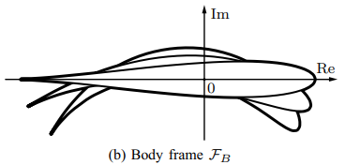
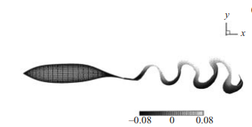
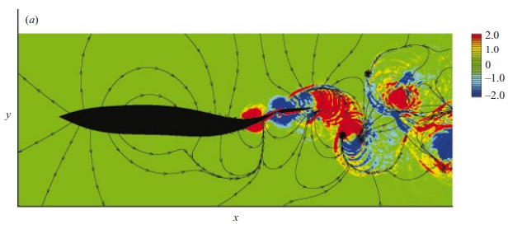
Related Work
Allows for computation of arbitrary profile deformation that cannot easily be defined by conformal transformations¹.
Studied for individuals by developing a fish-like profile, imposing a deformation parameter such that the profile bends while maintaining camber length and area¹.
Panel methods are implemented for numerical simulations on the giant Danio, with the caudal fin having chordwise sections of NACA 0016 shape².
[1] Xu, Y., & Mohseni, K. (2015)
[2] Zhu et. al (2002)

Slide 6
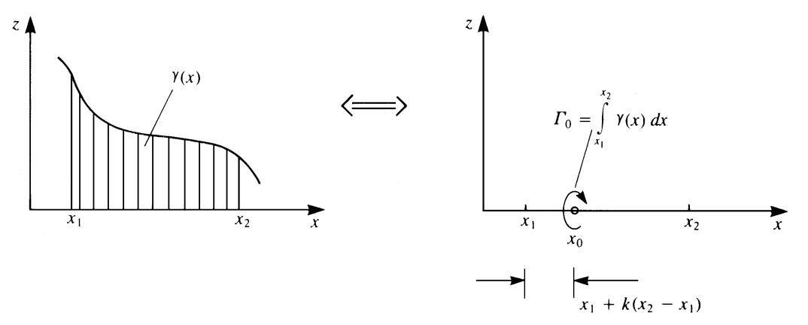
Vortex Panel Method
Point singularity solutions
Able to discretise γ (x) into finite segments
Influence coefficient calculations calculated using Kuethe and Chow¹
The following slides follow Katz and Plotkin’s formulation
Steady and Unsteady vortex panel methods created for the NACA0012 airfoil undergoing sudden forward motion (may be extended to pitching and heaving motions as well)
Choose Singularity Element
Discretisation/Grid generation
Compute Influence coefficients
Establish RHS vector
Solve the system
Compute Pressures, Loads, Velocities
[1] Kuethe, A. M., & Chow, C. Y. (1997)
[2] Katz, J. and Plotkin, A. (2001)
Notes:
If exact solution in a form of a continuous singularity distribution (e.g., a vortex distribution γ (x)) exists, then it can be divided into several finite segments (e.g., the segment between x1 and x2).

Slide 7
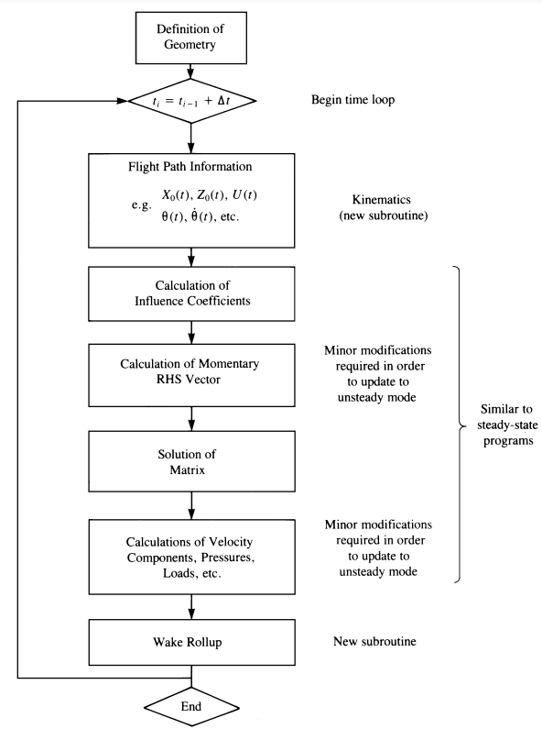
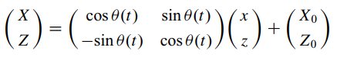
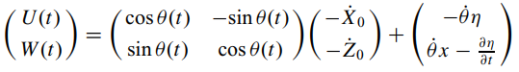
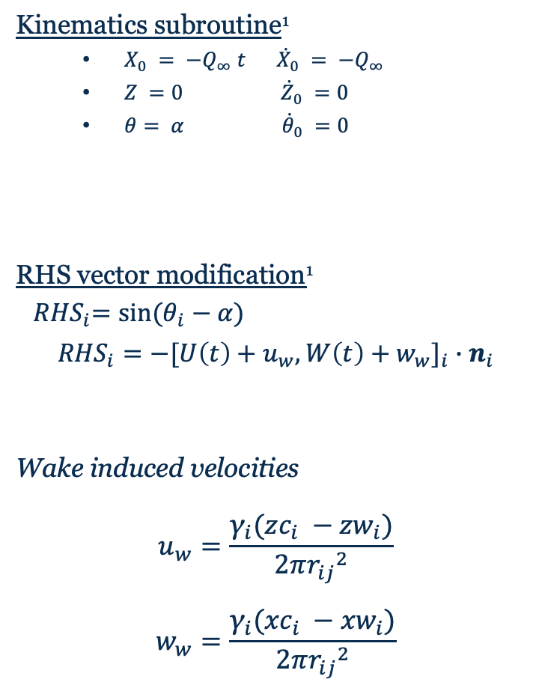
Modifications for the unsteady state: Sudden Forward Motion
Kinematics subroutine¹
$X_{0} = −Q_{∞} t$ ${\dot{X}}_{0} = −Q_{∞}$
$Z =0 {\dot{Z}}_{0} =0$
$θ= α {\dot{θ}}_{0} =0$
RHS vector modification¹
${ RHS}_{i}=sin⁡(θ_{i}−α)$
$${RHS}_{i}={−[U\left(t\right)+u_{w},W\left(t\right)+w_{w}]}_{i}∙n_{i}$$
Wake induced velocities
$$u_{w}=\frac{{\text{γ}}_{i}({zc}_{i} −{zw}_{i})}{2π{r_{ij}}^{2}}$$
$$w_{w}=\frac{{\text{γ}}_{i}({xc}_{i} −{xw}_{i})}{2π{r_{ij}}^{2}}$$
[1] Katz, J. and Plotkin, A. (2001)
Notes:
The time-dependent kinematic velocity components U(t), W(t)

Slide 8
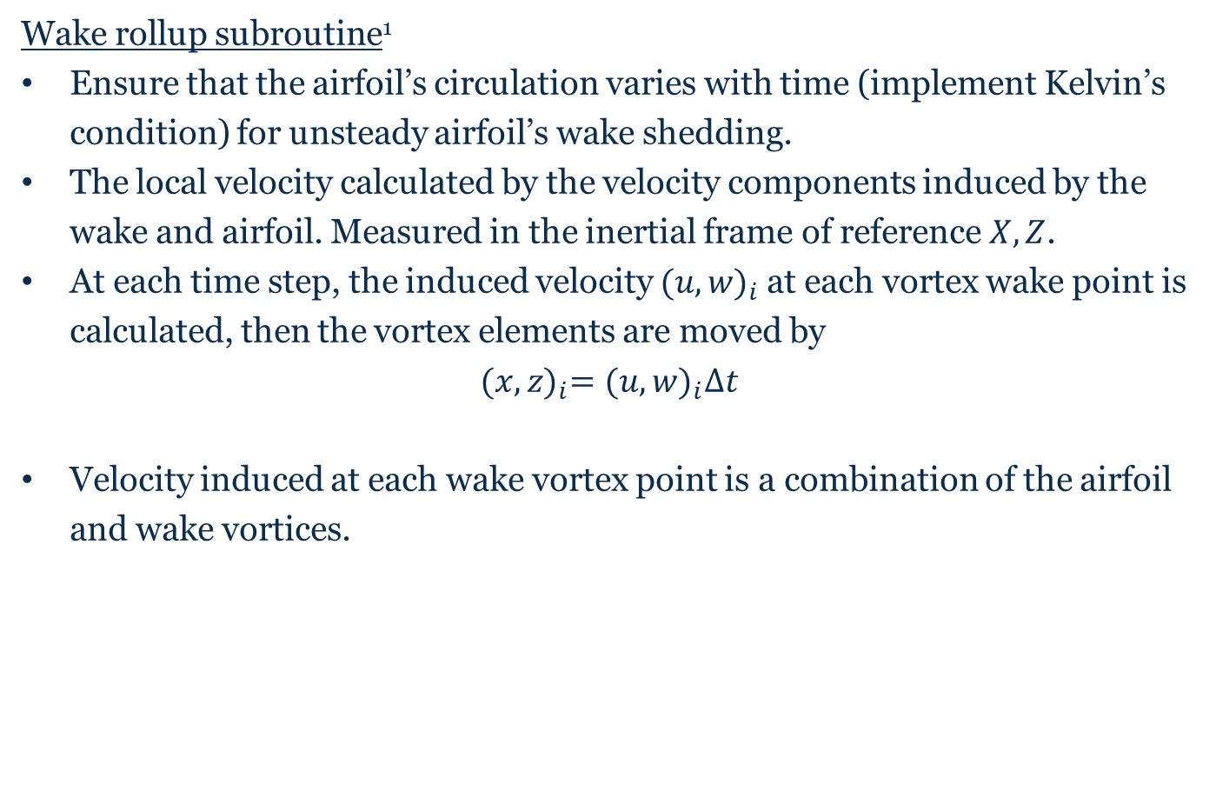
Modifications for the unsteady state (cont.)
Wake rollup subroutine¹
Ensure that the airfoil’s circulation varies with time (implement Kelvin’s condition) for unsteady airfoil’s wake shedding.
The local velocity calculated by the velocity components induced by the wake and airfoil. Measured in the inertial frame of reference $X, Z$.
At each time step, the induced velocity ${(u,w)}_{i}$at each vortex wake point is calculated, then the vortex elements are moved by
$${(x,z)}_{i}={(u,w)}_{i}∆t$$
Velocity induced at each wake vortex point is a combination of the airfoil and wake vortices.
[1] Katz, J. and Plotkin, A. (2001)

Slide 9
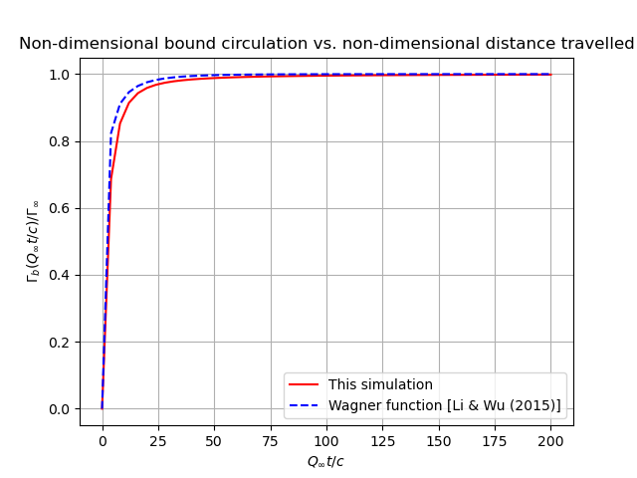
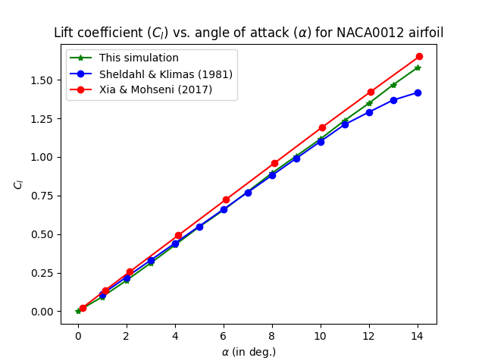
Sudden Forward motion
[1] Li and Wu (2015)
[2] Xia and Mohseni (2017)
[3] Sheldahl and Klimas (1981)

Slide 10
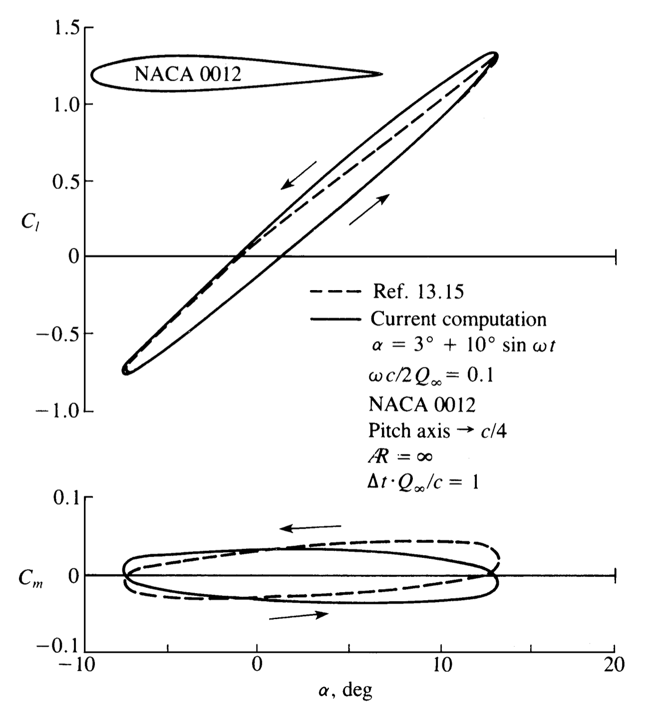
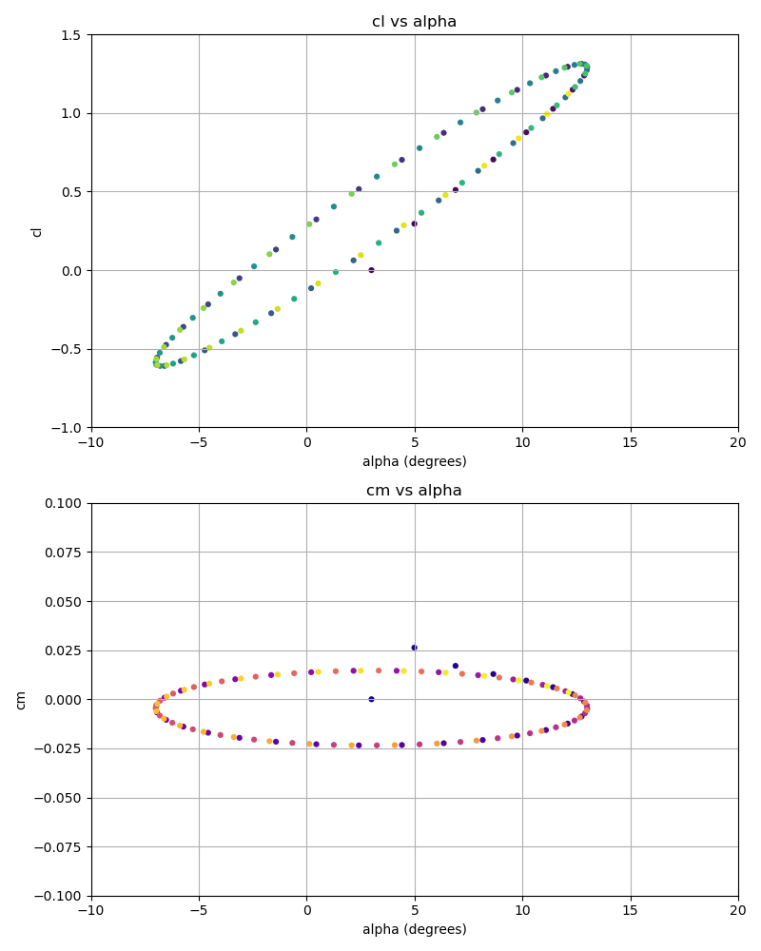
Pitching motion
[1] Katz, J. and Plotkin, A. (2001)

Slide 11
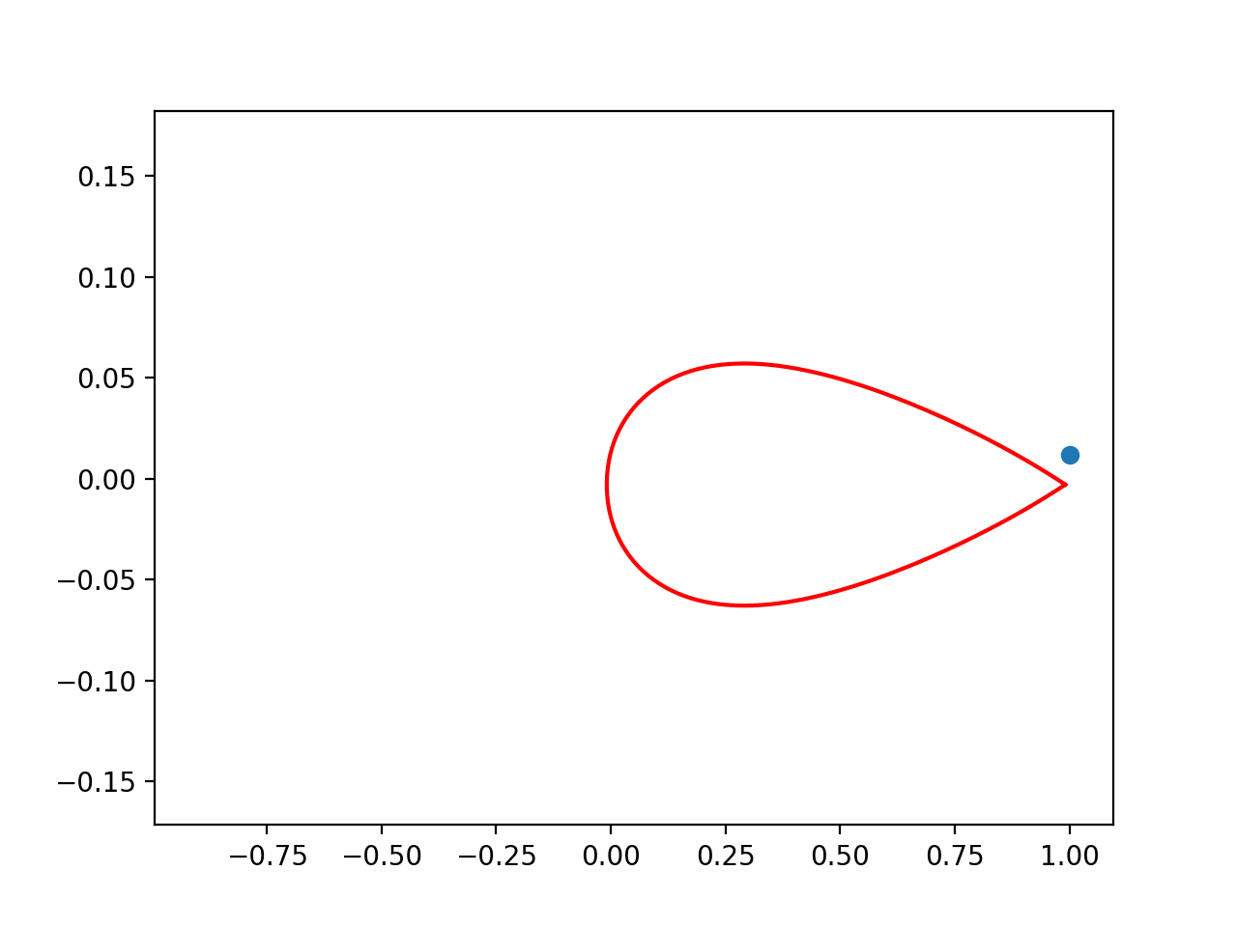
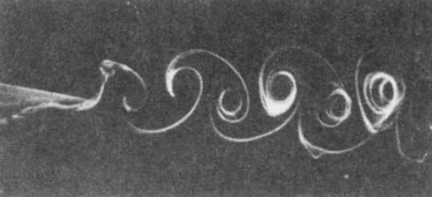
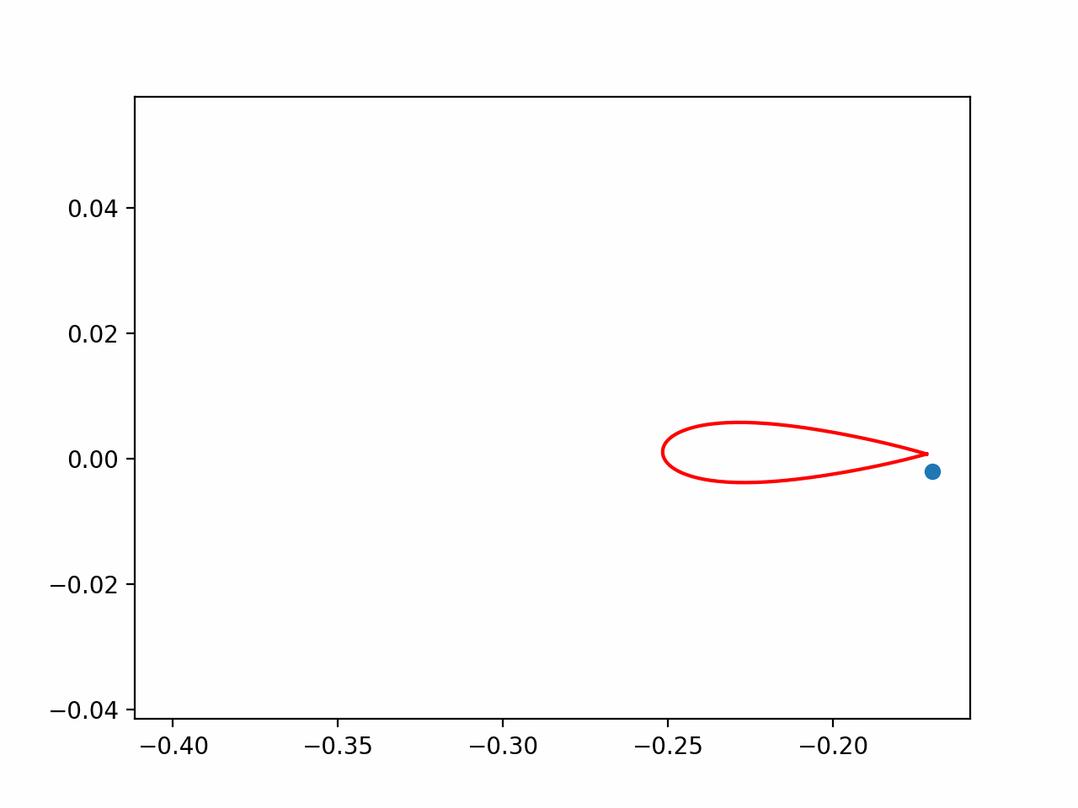
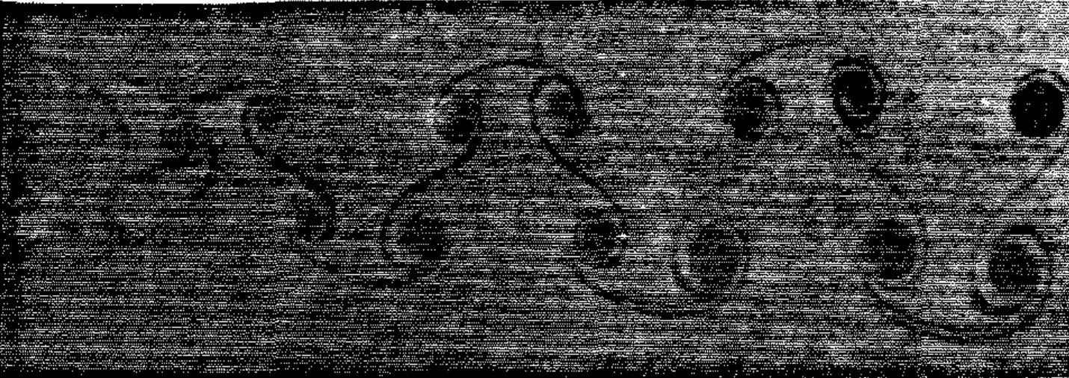
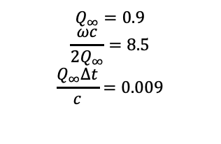
Animations
Heaving
$$Q_{∞}=0.9$$
$$\frac{ωc}{2Q_{∞}}=8.5$$
$$\frac{Q_{∞}Δt}{c}=0.009$$
Pitching
[1] Katz, J. and Plotkin, A. (2001)
[2] Koochesfahani (1989)

Slide 12
Future Work
Attempt to introduce a deformation parameter to realistically model the motion of fish
Integrating viscous forces and LEV in future simulation framework(s)
Looking at more complex geometries
Observe the motion of the fish with the deforming tail in the context of multiple individuals, progressing to looking in the context of a swarm
Extend model to 3D

